Slide 1
Boscos.out
Reproduce the binding energy
30/07/2025 meeting

Slide 2
Boscos.f Input file
197.32705359 1.43996518 20.736 * csts: hc,e2,hm
4.0 3.0 2 1 0 1 * Masses, charges, spins: Ac,Af (in amu),Zc,Zf,iSc,iSf
1 1 * c-f potential: ntypo,Njpo
-75.031 2.39 0.68 0.00 2.39 0.68 2.48 *j,l,Vp,rp,ap,VLS,rls,als,rC
1 * nb of bound states
1 3 1 * bound states: NR,J,l
20000 100 1e-6 * radial mesh:Nru,rmu,eps
1 1.0 1.0 * Energies: NE,E0,hE
0 * lec 0:E, 10:wf 1st state, 100:phaseshift, 110 bin
Li7testBS

Slide 3
197.32705359 1.43996518 20.736 * csts: hc,e2,hm
4.0 3.0 2 1 0 1 * Masses, charges, spins: Ac,Af (in amu),Zc,Zf,iSc,iSf
1 1 * c-f potential: ntypo,Njpo
-75.031 2.39 0.68 0.00 2.39 0.68 2.48 *j,l,Vp,rp,ap,VLS,rls,als,rC
1 * nb of bound states
1 3 1 * bound states: NR,J,l
20000 100 1e-6 * radial mesh:Nru,rmu,eps
1 1.0 1.0 * Energies: NE,E0,hE
0 * lec 0:E, 10:wf 1st state, 100:phaseshift, 110 bin
Li7testBS
— 2.50
2.467 — — — —
— 2.40
2.366 —
— 2.30
Ac= 4.000 Af= 3.000
Zc= 2 Zf= 1
deuxm= 8.26719577D-02 MeV^-1fm^-2 or 1/deuxm= 12.0960000D+00 MeV fm^2
l= 1 J= 3 NR= 1
E= -2.22347 MeV; K^2= -0.18382 fm^-2
ANC= 3.40151 fm^-1/2
— 2.20
2.135 —
— 2.10
E /MeV

Slide 4
Mass
Radius
Multiples of neutron, proton and average
hm [ ħ²/2m ] = 20.721 ; 20.750 ; 20.736 with Ac = 4.0 ; Af = 3.0
True (experimental) measures, in uma
hm [ ħ²/2m ] = 20.900796 with Ac = 4.002603 ; Af = 3.016049
Rc = 1.3 ∛A ; 1.27 ∛A ; 1.3(∛Ac + ∛Af) ; 1.27(∛Ac + ∛Af)
rC / fm = 2.48 ; 2.43 ; 3.94 ; 3.85

Slide 5
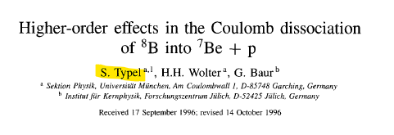

Slide 6
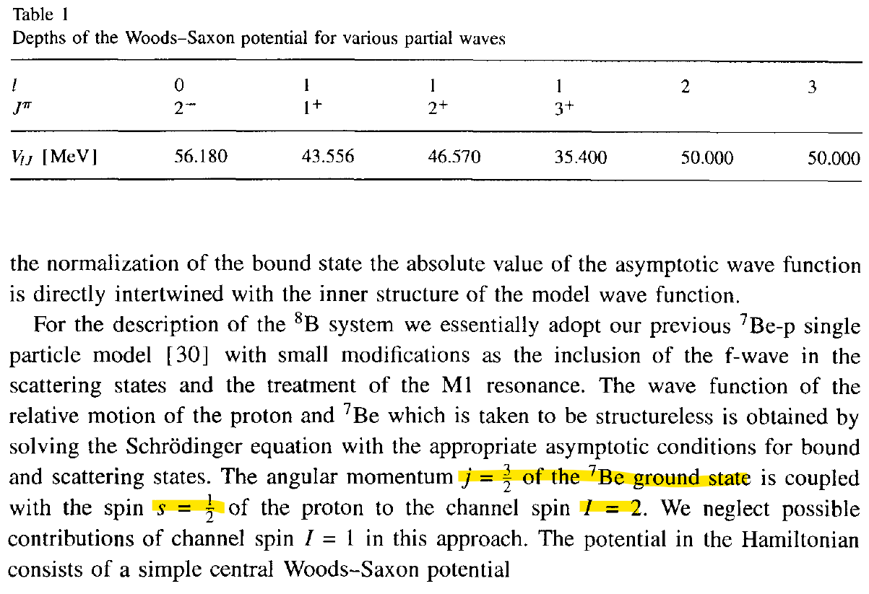
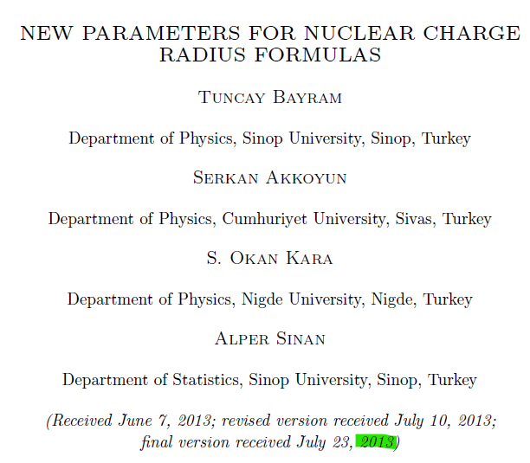
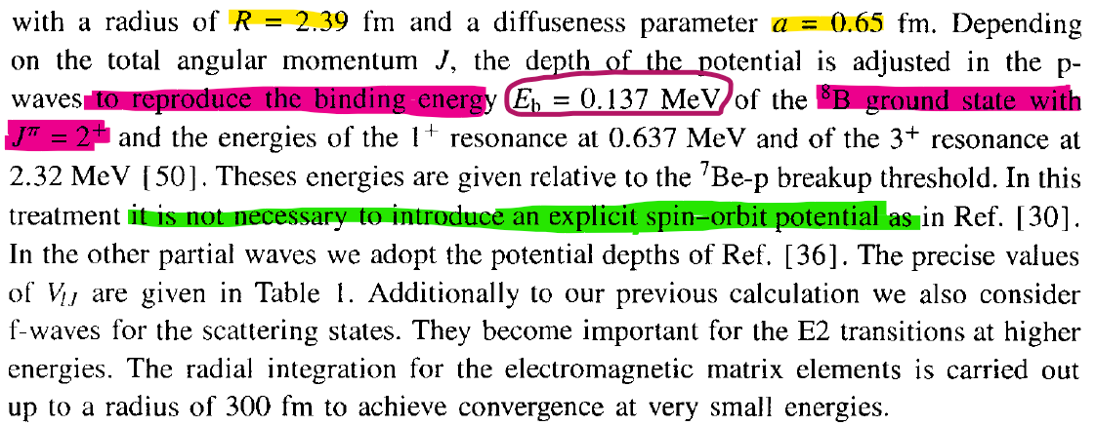

Slide 7

197.32705359 1.43996518 20.9007964040201 * csts: hc,e2,hm
7.0269691 1.007276466812 4 1 3 1 * Masses, charges, spins: Ac,Af (in amu),Zc,Zf,iSc,iSf
1 1 * c-f potential: ntypo,Njpo
-46.570 2.39 0.65 0.00 2.39 0.65 2.446 *j,l,Vp,rp,ap,VLS,rls,als,rC
1 * nb of bound states
0 4 1 * bound states: NR,J,l
20000 100 1e-6 * radial mesh:Nru,rmu,eps
1 1.0 1.0 * Energies: NE,E0,hE
0 * lec 0:E, 10:wf 1st state, 100:phaseshift, 110 bin
B8testBS
Ac= 7.027 Af= 1.007
Zc= 4 Zf= 1
deuxm= 4.21510886D-02 MeV^-1fm^-2 or 1/deuxm= 23.7241797D+00 MeV fm^2
l= 1 J= 4 NR= 0
E= -0.13641 MeV; K^2= -0.00575 fm^-2
ANC= 0.77166 fm^-1/2
Eb = 0.137 MeV

Slide 8

197.32705359 1.43996518 20.900796404 * csts: hc,e2,hm
4.002603254 3.016049281 2 1 0 1 * Masses, charges, spins: Ac,Af (in amu),Zc,Zf,iSc,iSf
1 1 * c-f potential: ntypo,Njpo
-75.031 2.39 0.68 0.00 2.39 0.68 2.33951 *j,l,Vp,rp,ap,VLS,rls,als,rC
1 * nb of bound states
1 3 1 * bound states: NR,J,l
20000 100 1e-6 * radial mesh:Nru,rmu,eps
1500 3.01 0.01 * Energies: NE,E0,hE
0 * lec 0:E, 10:wf 1st state, 100:phaseshift, 110 bin
Li7testBS
Ac= 4.003 Af= 3.016
Zc= 2 Zf= 1
deuxm= 8.22932852D-02 MeV^-1fm^-2 or 1/deuxm= 12.1516597D+00 MeV fm^2
l= 1 J= 3 NR= 1
E= -2.12579 MeV; K^2= -0.17494 fm^-2
ANC= 3.25461 fm^-1/2
Eb = 2.467 MeV

Slide 9
Conclusions
Question: Is something wrong with Tokimoto’s paper?
Use the empirical masses. For 8B and 6Li (Hammache) were used.
Rc = 2.33951 is good estimation. Dubovichenko experim. R(7Li) = 2.35(10) fm
In any case, changes in mass and the radius have little impact.
Something else must be tuned.

Slide 10
→ Refit ???
→ Spin-Orbit interaction
In principle, for 7Li the spin-orbit contribution must be significant.
No mention is made of spin-orbit in Tokimoto (nor is it explicitly stated that it is not used, unlike for 8B). → They might have forgotten
But, trying to find manually a value of Vso for p waves, we came to trouble
 | Exper. Eb /MeV | Simul. E without | Vso | Simul. E with
p3/2 | 2.467 | 2.12579 | 9.40 | 2.46824
p1/2 | 1.99039 | 1.67665 | -4.60 | 1.99430

